Slide 1
Domain: Block Chain
Technology: Python
Predicting the Price of Bitcoin Using Machine Learning

Slide 2
Abstract
Introduction
Literature review
Existing Method
Drawbacks
Proposed method
Applications
Hardware and Software Requirements
Results
Conclusion
References

Slide 3
OBJECTIVE
The objective of this project is about forecasting for an bit coin data. Investing in Crypt-Currency have been increased a lot when compare to the earlier days. If we contribute to prevent the risk on investments, then it should be able to utilize for us, this study attempts to perform future forecasting on the price, by which we can control the risk. Our model will help to create future predictions which reduce the burden to the people who are continuously working on these.

Slide 4
ABSTRACT
The goal of this paper is to ascertain with what accuracy the direction of Bitcoin price in USD can be predicted. The price data is sourced from the Bitcoin Price Index. The task is achieved with varying degrees of success through the implementation. The Random Forest achieves the highest classification accuracy. Finally, both deep learning models are benchmarked on both a GPU and a CPU with the training time on the GPU outperforming the CPU implementation by 67.7%.

Slide 5
INTRODUCTION:
Bitcoin is the worlds’ most valuable crypto currency and is traded on over 40 exchanges worldwide accepting over 30 different currencies. It has a current market capitalization of 9 billion USD according to https://www.blockchain.info/ and sees over 250,000 transactions taking place per day. As a currency, Bitcoin offers a novel opportunity for price prediction due its relatively young age and resulting volatility, which is far greater than that of fiat currencies. It is also unique in relation to traditional fiat currencies in terms of its open nature; no complete data exists regarding cash transactions or money in circulation for fiat currencies. Prediction of mature financial markets such as the stock market has been researched at length. Bitcoin presents an interesting parallel to this as it is a time series prediction problem in a market still in its transient stage. Traditional time series prediction methods such as Holt-Winters’s exponential smoothing models rely on linear assumptions and require data that can be broken down into trend, seasonal and noise to be effective.

Slide 6
Traditional time series prediction methods such as Holt-Winters’s exponential smoothing models rely on linear assumptions and require data that can be broken down into trend, seasonal and noise to be effective. This type of methodology is more suitable for a task such as forecasting sales where seasonal effects are present. Due to the lack of seasonality in the Bitcoin market and its high volatility, these methods are not very effective for this task. Given the complexity of the task, deep learning makes for an interesting technological solution based on its performance in similar areas.

Slide 7
The aim of this paper is to investigate with what accuracy the price of Bitcoin can be predicted using machine learning and compare parallelization methods executed on multi-core and GPU environments. This paper contributes in the following manner: of approximately 653 papers published on Bitcoin, only 7 (at the time of writing) are related to machine learning for prediction. To facilitate a comparison to more traditional approaches in financial forecasting, an Random Forest is also developed for performance comparison purposes

Slide 8
LITERATURE REVIEW
SL.NO | Title | Outcomes
1 | Bitcoin: A peer-to-peer electronic cash system | double-spending problem using a peer-to-peer network. The network timestamps transactions by hashing them into an ongoing chain of hash-based proof-of-work, forming a record that cannot be changed without redoing the proof-of-work
2 | Virtual currency, tangible ` return: Portfolio diversification with bitcoins | the inclusion of even a small proportion of Bitcoins may dramatically improve the risk-return trade-off of well-diversified portfolioson geographic location and age
3 | Designing a neural network for forecasting financial and economic time series | eight-step procedure to design a neural network forecasting model is explained including a discussion of tradeoffs in parameter selection, some common pitfalls, and points of disagreement among practitioners

Slide 9
LITERATURE REVIEW
4 | Economic prediction using neural networks: The case of ibm daily stock returns, | decode nonlinear regularities in asset price movements
5 | Holt-winters forecasting: some practical issues | Some practical problems in implementing the method are discussed, including the normalization of seasonal indices, the choice of starting values and the choice of smoothing parameters. There is an important distinction between an automatic and a non-automatic approach to forecasting and detailed suggestions are made for implementing Holt-Winters in both ways. The question as to what underlying model, if any, is assumed by the method is also addressed. Some possible areas for future research are then outlined.
6 | Bitcoin academic paper database | Our study provides a knowledge area map that identifies and evaluates the links between authors and countries distribution, the conceptual structure of the field, the structure and connections of most cited papers and journals.

Slide 10
EXISTING METHOD
To fully understand just how powerful forecasting live is need to look at it from the very beginning which is traditional forecasting. Traditional forecasting basically uses historical observations to estimate future business metrics like inventory requirements, budgets, revssenue and asset performance. Traditional forecasting practices fail because the past does not necessarily represent the future. Machine Learning have different types of algorithms and each has its own structure of working procedure which contains different intuitions. In these intuitions, models are working on different procedures in different ways and also delivers high and less accuracies. This creates a lot of constraints regarding cases, fatalities and recoveries available. The major challenge is to create a model for them so that no one have less accuracy. In this existing system we used KNN and Logistic regression which results less accuracy. Such a models won’t be able to match with our requirements and it also consumes more time.

Slide 11
DISADVANTAGES IN EXISTING METHOD
Low efficiency.
Time consuming.
High complexities.
Resources consuming

Slide 12
PROPOSED METHOD
We propose this application that can be considered a useful system since it helps to reduce the limitations obtained from Random Forest. By providing support through the forecasting analysis, it can be able to generate best results for attributes without any overlap.

Slide 13
ADVANTAGES
• High efficiency.
• Time Saving.
• Inexpensive.
• Low complexities.

Slide 14
APPLICATIONS
Low complexity.
Highly efficient

Slide 15
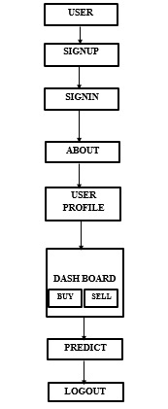
FLOW

Slide 16
Hardware and Software Requirements
H/W SPECIFICATIONS:
• Processor - I3/Intel Processor
• RAM - 8GB (min)
• Hard Disk - 128 GB
• Key Board - Standard Windows Keyboard
• Mouse - Two or Three Button Mouse
• Monitor - Any

Slide 17
Hardware and Software Requirements
• Operating System : Windows 10
• Server-side Script : Python 3.6
• IDE : PyCharm
• Libraries Used : Pandas, MYSQL
• Framework : Flask.

Slide 18
IMPLEMENTATION
This modules includes Home Page, user Signup,signin page
User has to register and then only he/she can login into the system . After successful login user can view his profile and dashboard .In dashboard there is an dynamic graph .With that graph user predicts the net outcome and can store the count of bit coins also.

Slide 19
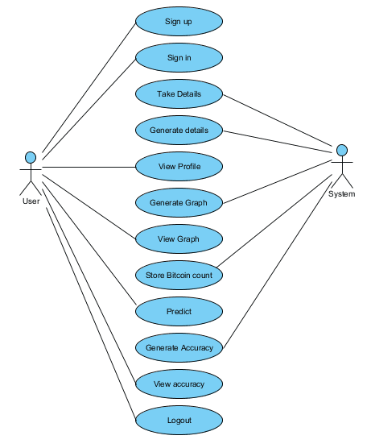
Use case diagram:

Slide 20
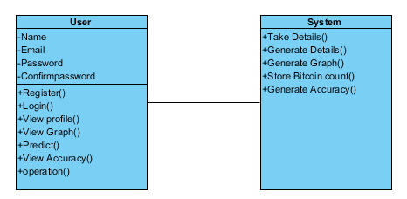
Class diagram:

Slide 21
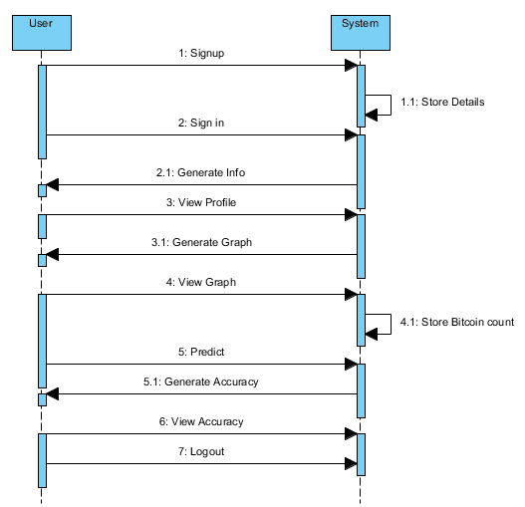
Sequence diagram:

Slide 22
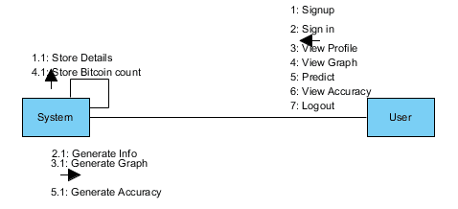
Collaboration diagram

Slide 23
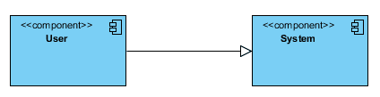
Component diagram:

Slide 24
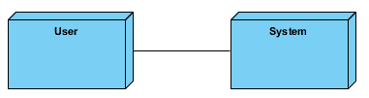
Deployment diagram:

Slide 25
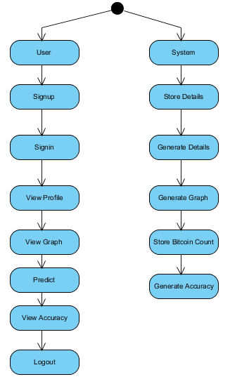
Activity diagram:

Slide 26
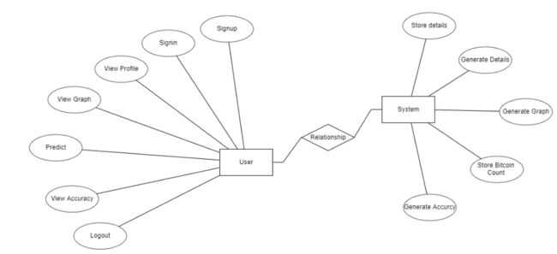
ER diagram:

Slide 27

DFD diagram:

Slide 28
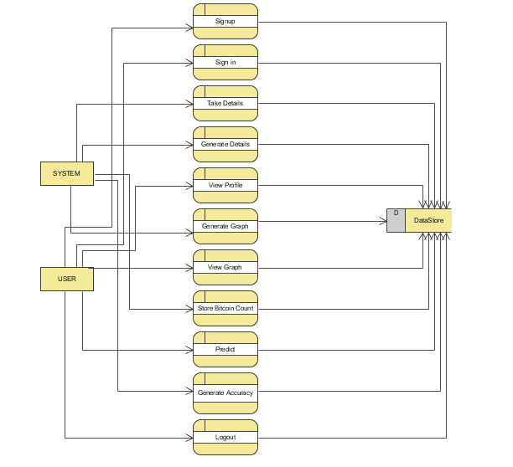

Slide 29
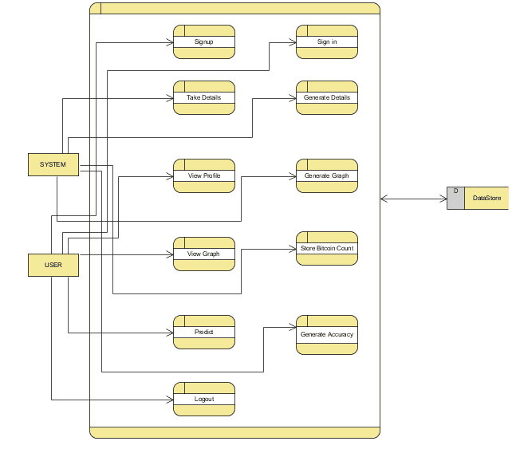

Slide 30

Results and Discussions Home Page

Slide 31
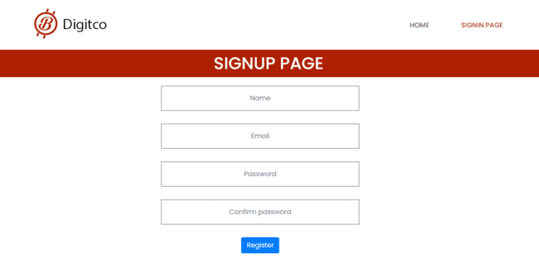
Results and Discussions Sign Page

Slide 32

Results and Discussions Sign In

Slide 33

Results and Discussions Home Page

Slide 34

Results and Discussions Profile page

Slide 35
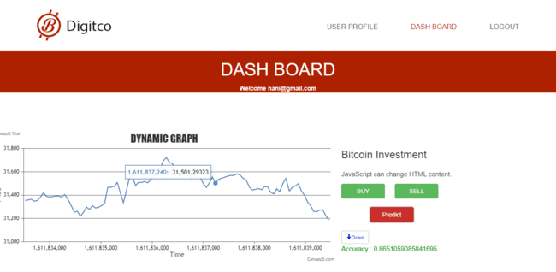
Results and Discussions Dash Board Page

Slide 36
CONCLUSION
In this application, we have successfully created a model to generate future outcomes for crypto currency called Bitcoin. This is developed in a user-friendly environment using Python programming.

Slide 37
FUTURE SCOPE
This application can be extended to include the ability to predict the future prices. we plan to explore the prediction methodology using the updated dataset and use the most accurate and appropriate methods for forecasting. Real-time live forecasting will be one of the primary focus in our future work.

Slide 38
REFERENCES
[1] S. Nakamoto, “Bitcoin: A peer-to-peer electronic cash system,” 2008.
[2] M. Briere, K. Oosterlinck, and A. Szafarz, “Virtual currency, tangible `return: Portfolio diversification with bitcoins,” Tangible Return: Portfolio Diversification with Bitcoins (September 12, 2013), 2013.
[3] I. Kaastra and M. Boyd, “Designing a neural network for forecasting financial and economic time series,” Neurocomputing, vol. 10, no. 3, pp. 215–236, 1996.
[4] H. White, “Economic prediction using neural networks: The case of ibm daily stock returns,” in Neural Networks, 1988., IEEE International Conference on. IEEE, 1988, pp. 451–458.
[5] C. Chatfield and M. Yar, “Holt-winters forecasting: some practical issues,” The Statistician, pp. 129–140, 1988.
[6] B. Scott, “Bitcoin academic paper database,” suitpossum blog, 2016.
[7] M. D. Rechenthin, “Machine-learning classification techniques for the analysis and prediction of high-frequency stock direction,” 2014.

Slide 39
[8] D. Shah and K. Zhang, “Bayesian regression and bitcoin,” in Communication, Control, and Computing (Allerton), 2014 52nd Annual Allerton Conference on. IEEE, 2014, pp. 409–414.
[9] G. H. Chen, S. Nikolov, and D. Shah, “A latent source model for nonparametric time series classification,” in Advances in Neural Information Processing Systems, 2013, pp. 1088–1096.
[10] I. Georgoula, D. Pournarakis, C. Bilanakos, D. N. Sotiropoulos, and G. M. Giaglis, “Using time-series and sentiment analysis to detect the determinants of bitcoin prices,” Available at SSRN 2607167, 2015.
[11] M. Matta, I. Lunesu, and M. Marchesi, “Bitcoin spread prediction using social and web search media,” Proceedings of DeCAT, 2015.
[12] “The predictor impact of web search media on bitcoin trading volumes.”
[13] B. Gu, P. Konana, A. Liu, B. Rajagopalan, and J. Ghosh, “Identifying information in stock message boards and its implications for stock market efficiency,” in Workshop on Information Systems and Economics, Los Angeles, CA, 2006.
[14] A. Greaves and B. Au, “Using the bitcoin transaction graph to predict the price of bitcoin,” 2015.
[15] I. Madan, S. Saluja, and A. Zhao, “Automated bitcoin trading via machine learning algorithms,” 2015.

